Slide 1
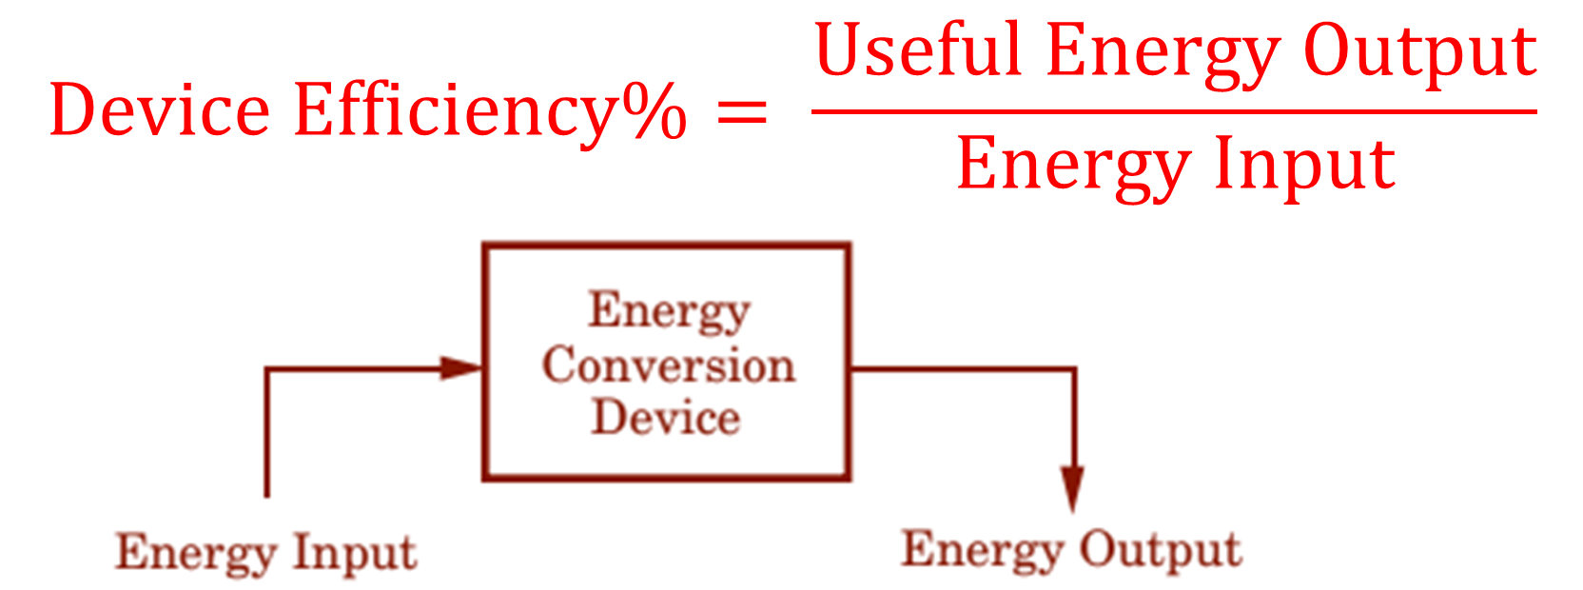
Notes:
Teacher note- cut out and have students paste in notes

Slide 2
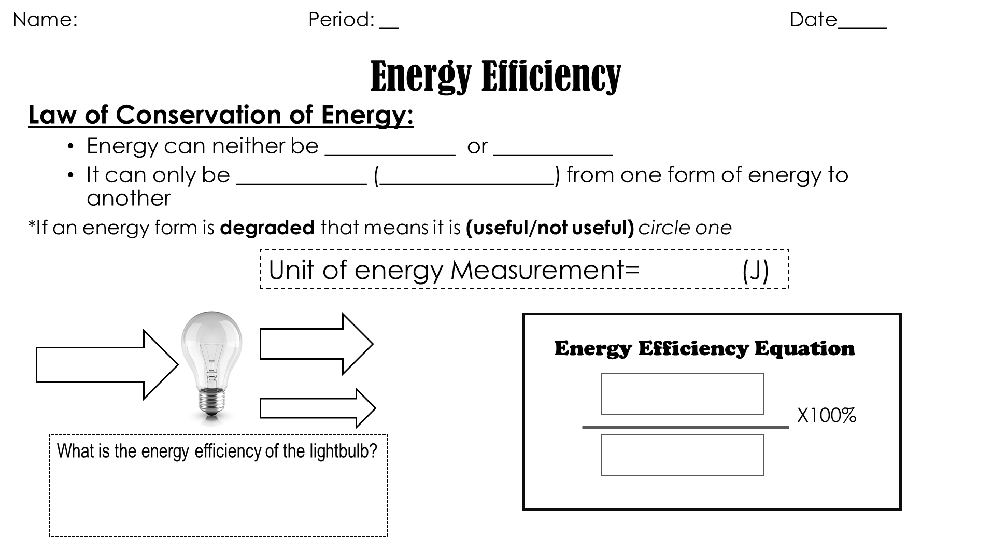
Notes:
Teacher note- student note-sheet

Slide 3

Energy Efficiency

Slide 4
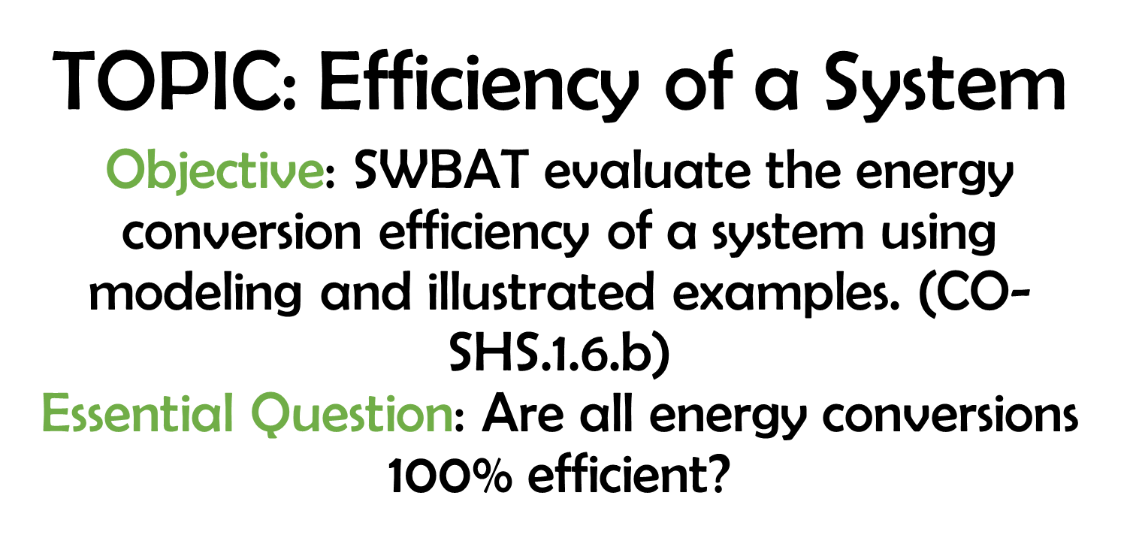

Slide 5
The Law of Conservation of Energy:
Energy can neither be created nor destroyed.
But it can be changed (transformed!) from one form of energy to another!

Slide 6
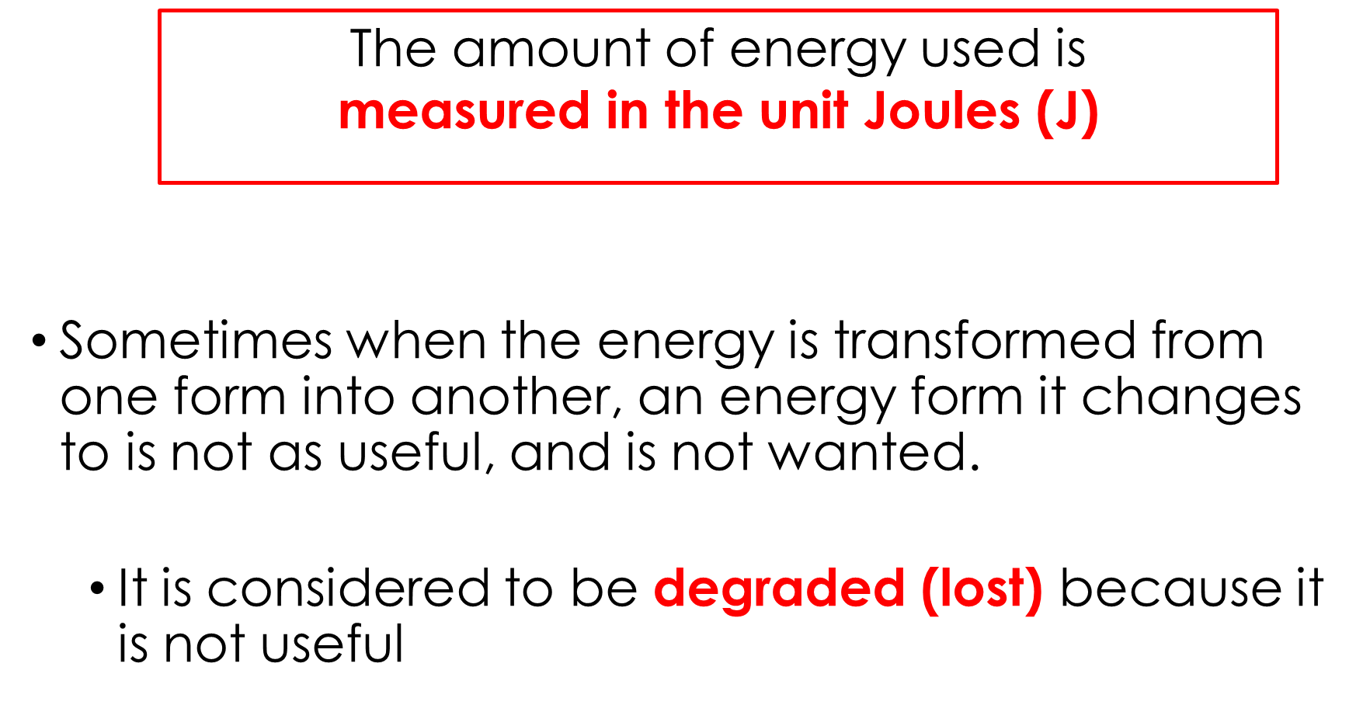

Slide 7
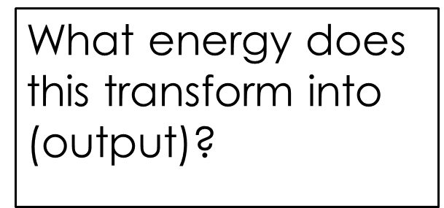


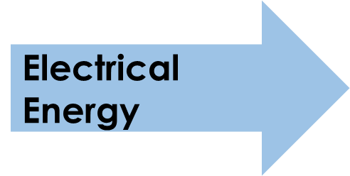

Energy Transformation-
What type of energy input does a lightbulb receive when it is plugged into a circuit?
What energy goes in?

Slide 8
Is any of these energy forms considered degraded energy?
(not needed) Which one?
Light Energy
Light Energy
Electrical Energy
Electrical Energy
Heat Energy
Heat Energy
degraded

Slide 9

Energy Efficiency
Efficiency is the term used to describe how well something does it’s job and how little energy it requires to do that job.
Why is this important?
Knowing how energy efficient something is, helps people to decide which device will cost less to use!

Slide 10

Energy Efficiency Equation
ENERGY EFFICIENCY = ENERGY OUT
ENERGY IN
useful
X100%

Slide 11
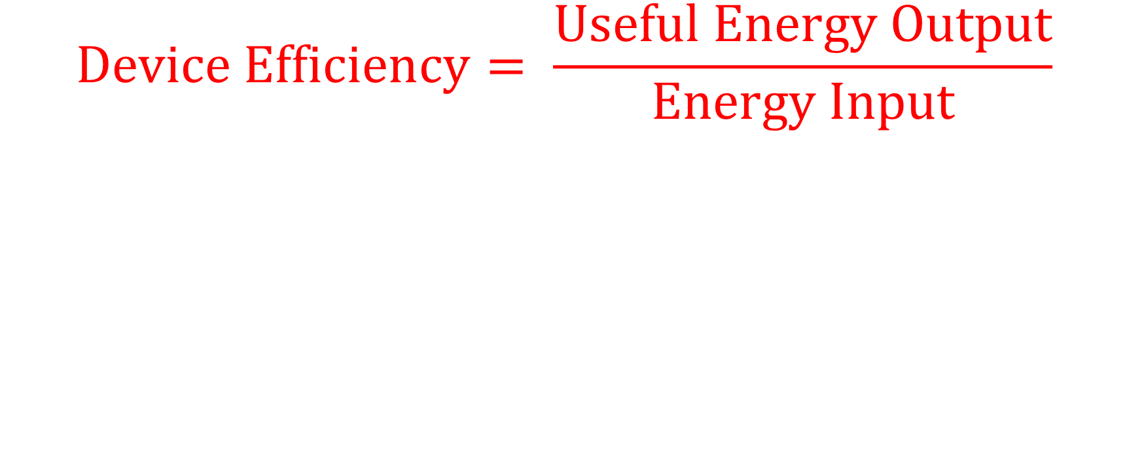
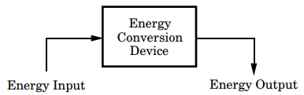

Slide 12
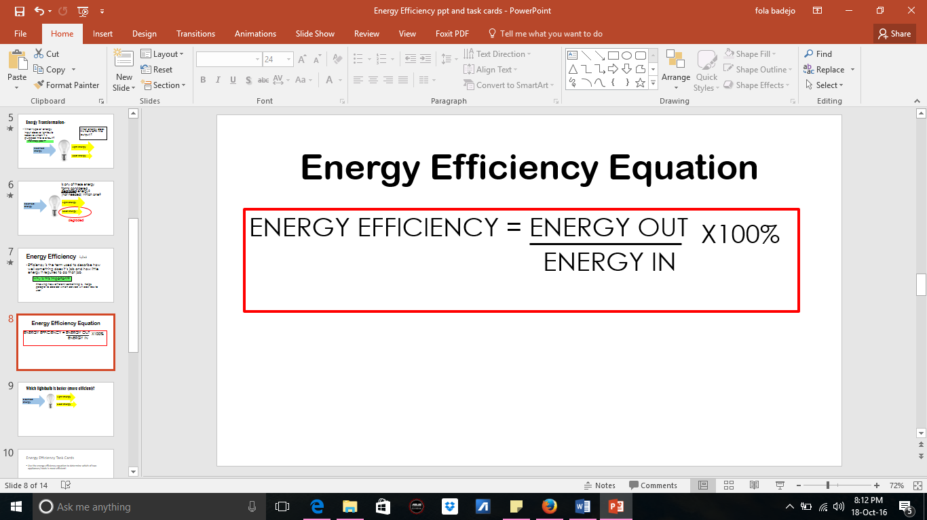
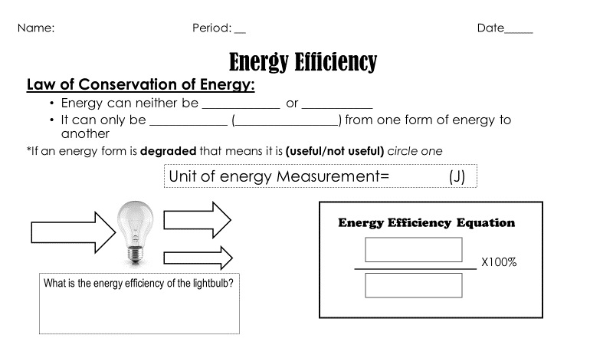
120J
Electrical Energy
75J Light Energy
useful
45J Heat Energy
75J
120 J X 100%
= 62.5% Energy Efficient

Slide 13
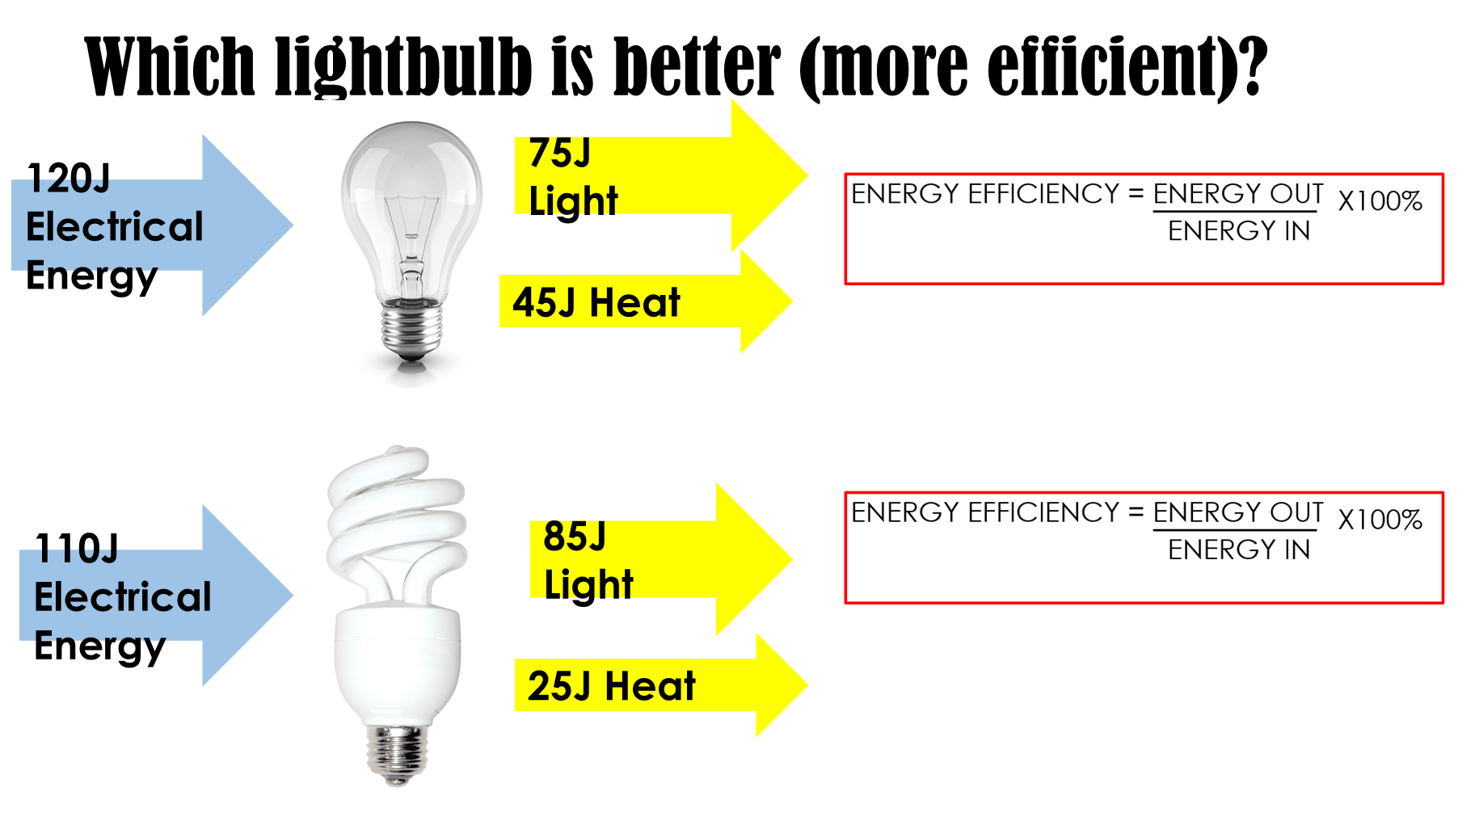

Slide 14
Energy Efficiency Task Cards
Use the energy efficiency equation to determine which of two appliances/ tools is more efficient!

Slide 15
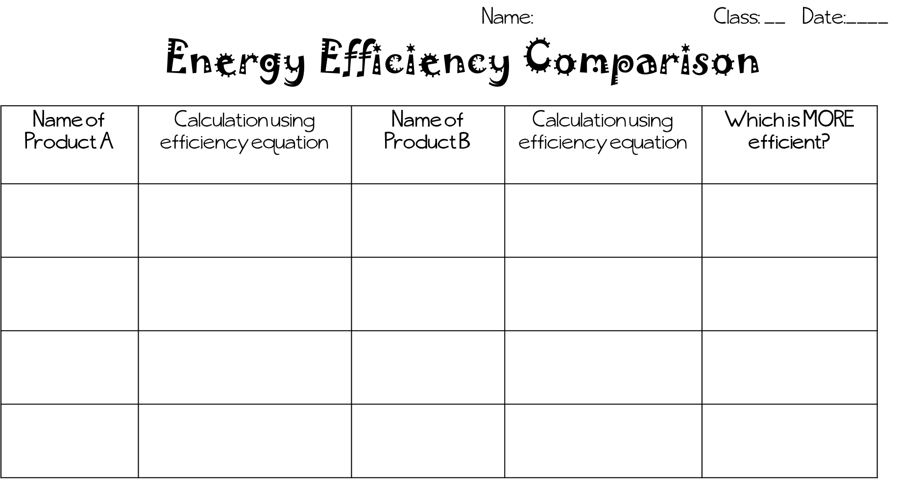

Slide 16
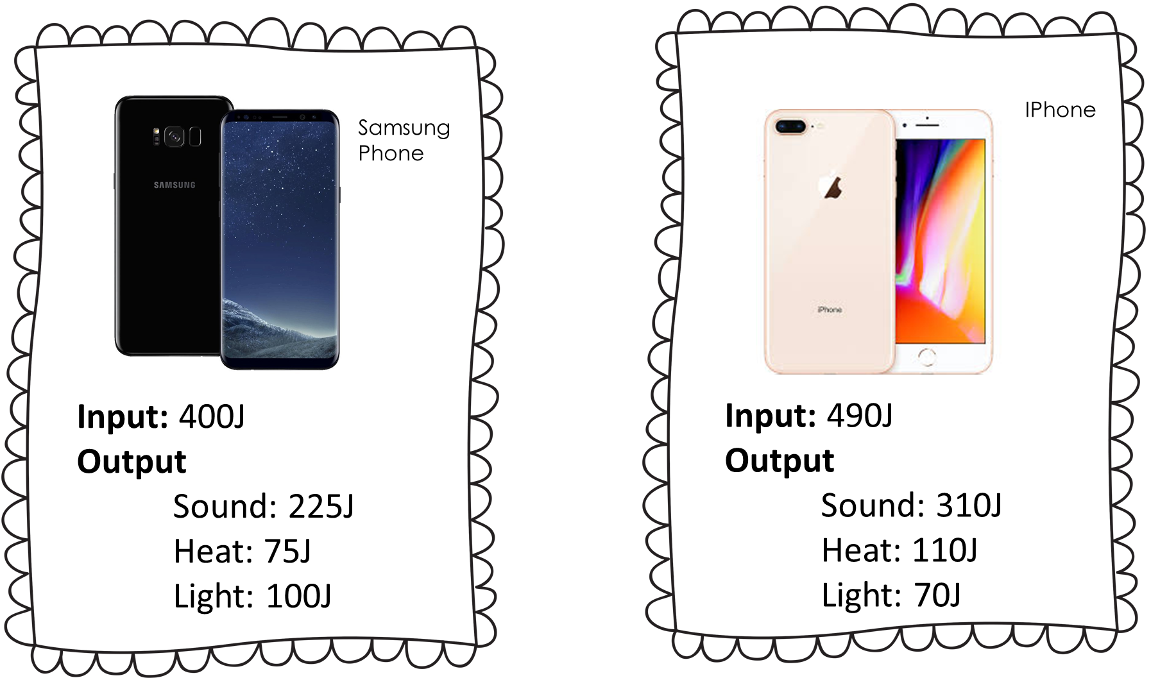

Slide 17
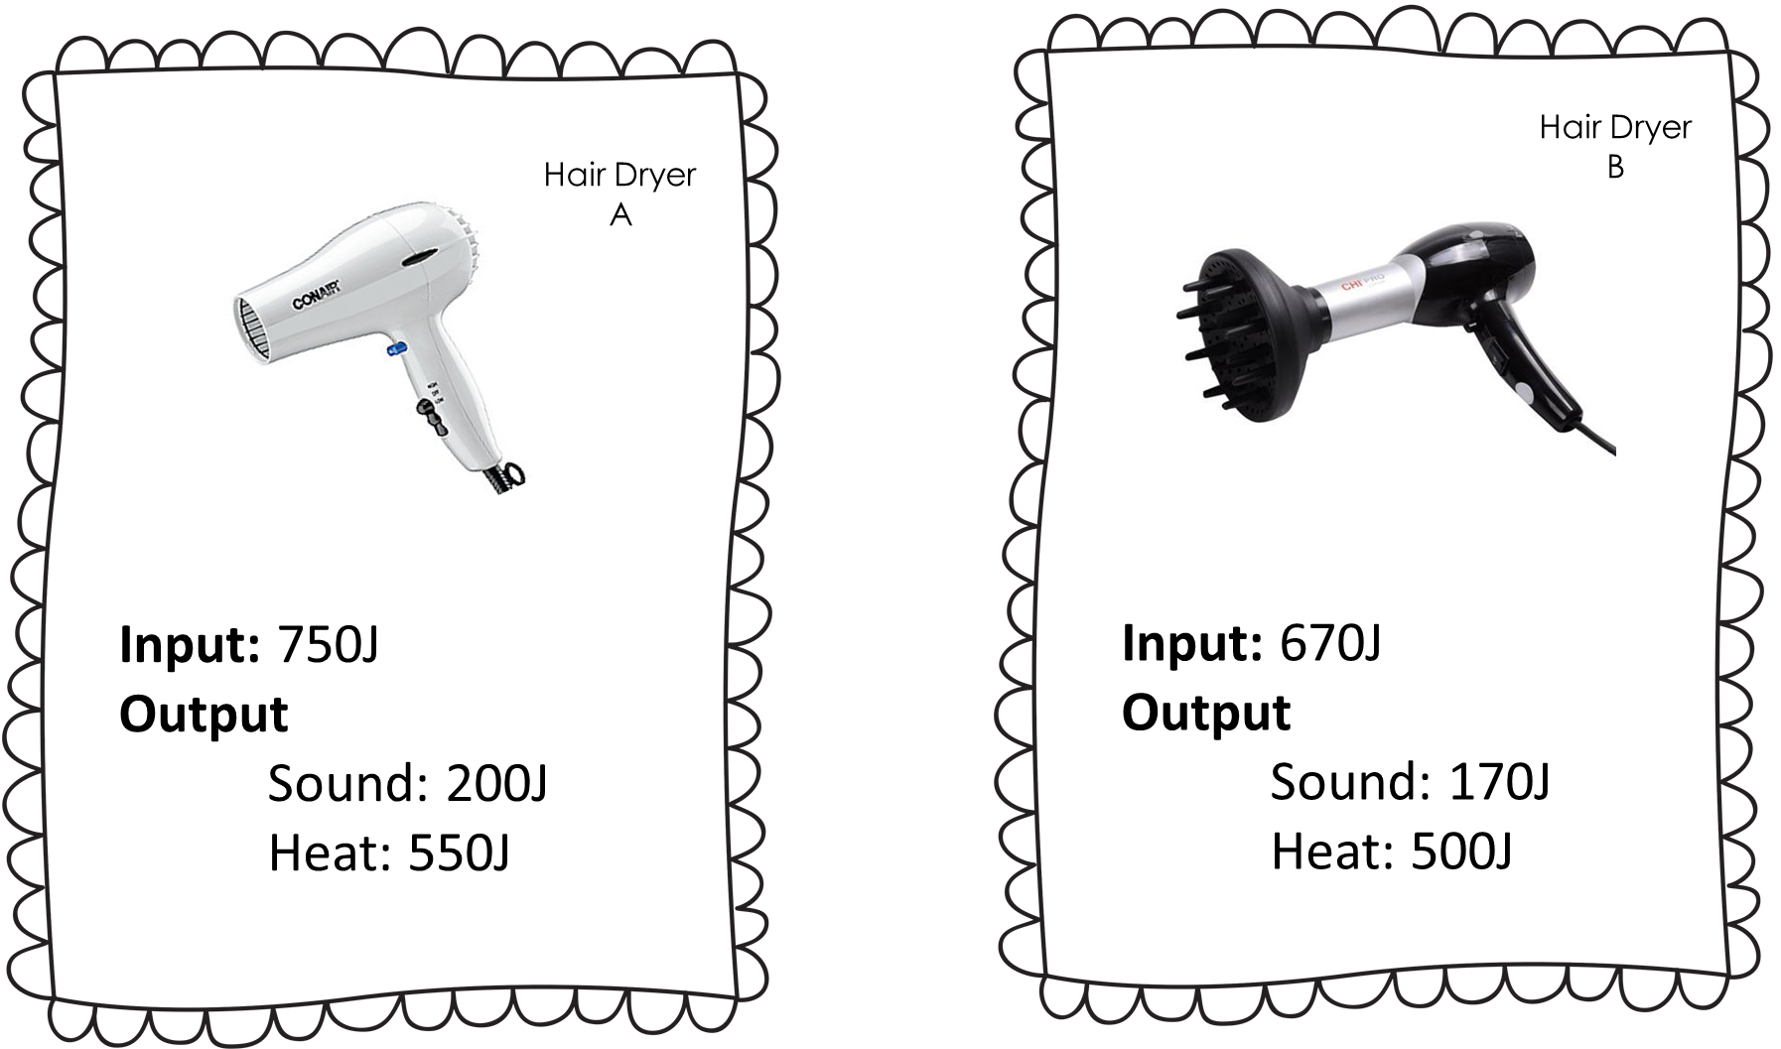

Slide 18
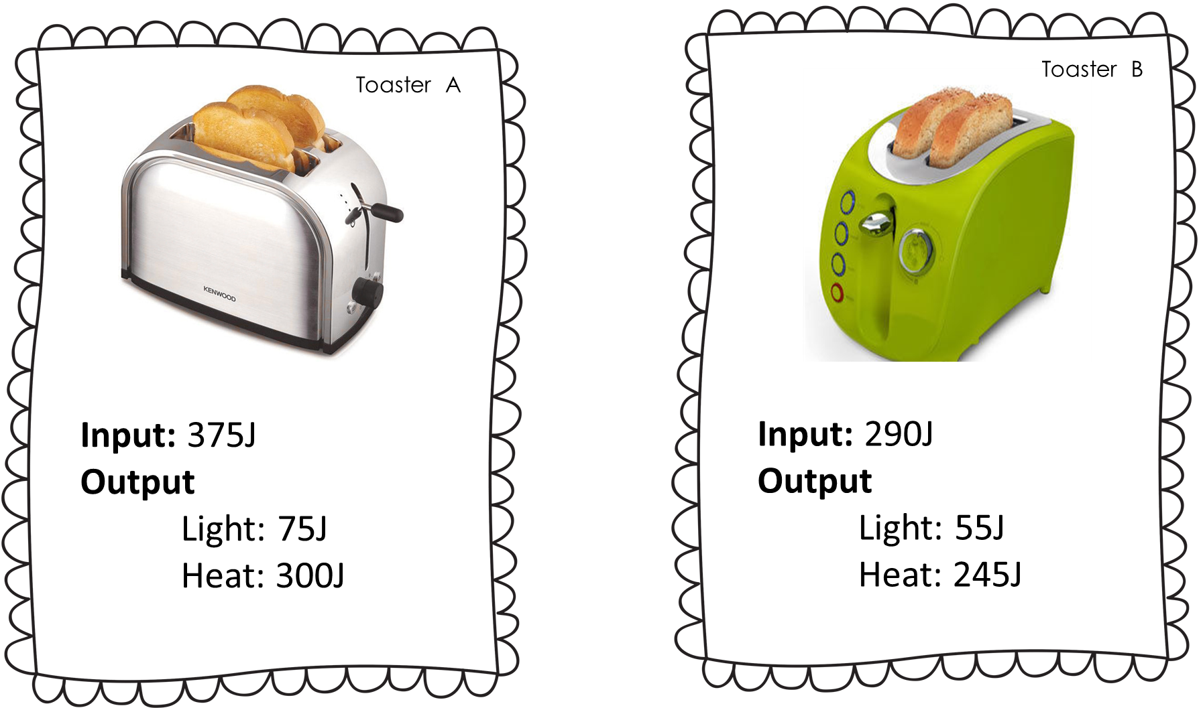

Slide 19
